Slide 1
How to solve water Problems in India
By Ayushi Malik

Slide 2
Contents
What is Water Crises?
Current Situation in India
Effects
Conclusion

Slide 3
What is Water Crises?
India’s water crises is attributed by lack of government planning
Industrial and human waste and government corruption
Water scarcity in India is expected to worsen as the overall population is expected to increase to 1.6 billion by year 2050

Slide 4
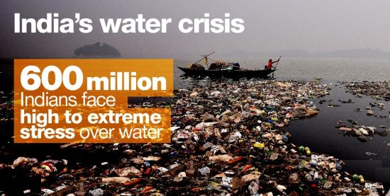
Current Situation In India
.

Slide 5
Effects
Water Pollution
Delay in monsoon and change in pattern
Deforestation and mismanagement of wetlands
Lack of Drinking Water

Slide 6
Conclusion
India is water rich country and is capable of managing water scarcity
Rain Water Harvesting
Afforestation
Water Conservation

Slide 7
Thank You
.

